Slide 1
Murach’s ASP.NET Core MVC (2nd Ed.)
Chapter 8
How to transfer data from controllers

Slide 2
Objectives (part 1)
Applied
Use the ViewBag and ViewData properties to transfer data from a controller to a view.
Use a view model to transfer data from a controller to a strongly-typed view.
Develop web apps that redirect and use the TempData property to transfer data from a controller to a controller.
Knowledge
Describe some important interfaces and classes of the ActionResult hierarchy.
Distinguish between the ViewBag and ViewData properties.
Describe the use of a view model to transfer data from a controller to a view.

Slide 3
Objectives (part 2)
Describe how one action method can redirect to another action method.
Describe the use of the PRG pattern to prevent resubmission of POST data.
Distinguish between the ViewData and TempData properties.
Describe the purpose of the Keep() and Peek() methods of the TempData class.

Slide 4
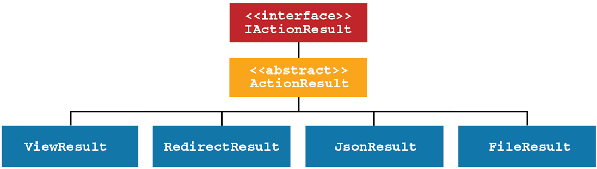
The ActionResult hierarchy

Slide 5
Common ActionResult subtypes
ViewResult
RedirectResult
RedirectToActionResult
JsonResult
FileResult
StatusCodeResult
ContentResult
EmptyResult
A URL for a full list of the ActionResult subtypes
https://docs.microsoft.com/en-us/dotnet/api/
microsoft.aspnetcore.mvc.actionresult

Slide 6
Some methods of the Controller class that return an ActionResult object
View()
Redirect()
RedirectToAction()
File()
Json()
Some of the overloads of the View() method
View()
View(model)
View(name)
View(name, model)

Slide 7
An action method that returns a ViewResult object
public ViewResult List() {
var names = new List<string> { "Grace", "Ada", "Charles" };
return View(names);
}
An action method that returns a RedirectToActionResult object
public RedirectToActionResult Index() => RedirectToAction("List");
An action method that may return different types of result objects
[HttpPost]
public IActionResult Edit(string id) {
if (ModelState.IsValid)
return RedirectToAction("List");
else
return View((object)id); // cast string model to object
}

Slide 8
Controller code that adds two items to the ViewData property
public ViewResult Index() {
ViewData["Book"] = "Alice in Wonderland";
ViewData["Price"] = 9.99;
return View();
}

Slide 9
Some properties of the ViewDataDictionary class
Count
Keys
Values

Slide 10
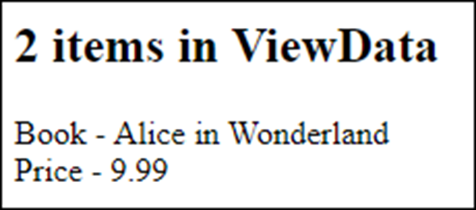
Razor code that displays all the items in the ViewData object
<h2>@ViewData.Count items in ViewData</h2>
@foreach (KeyValuePair<string, object?> item in ViewData) {
<div>@item.Key - @item.Value</div>
}
The view in the browser

Slide 11

Razor code that casts a ViewData object to the double type
<h4>Price: @(((double)ViewData["Price"]).ToString("c"))</h4>
The view in the browser

Slide 12
Razor code that checks ViewData for null
Cast a value type (double) to a nullable type
<h4>Price: @(((double?)ViewData["Price"])?.ToString("c"))</h4>
Cast a reference type (string) to a nullable type
<h4>Book: @ViewData["Book"]?.ToString().ToUpper()</h4>

Slide 13
Controller code that adds two dynamic properties to the ViewBag property
public ViewResult Index() {
ViewBag.Book = "Alice in Wonderland";
ViewBag.Price = 9.99;
return View();
}

Slide 14
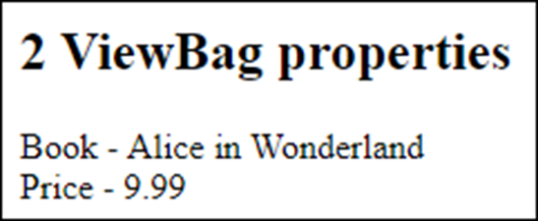
Razor code that uses ViewData to display ViewBag properties
<h2>@ViewData.Count ViewBag properties</h2>
@foreach (KeyValuePair<string, object?> item in ViewData) {
<div>@item.Key - @item.Value</div>
}
The view in the browser

Slide 15
Razor code that works with a ViewBag property without casting
<h4>Price: @ViewBag.Price.ToString("c")</h4>
The view in the browser

Slide 16
Razor code that checks ViewBag properties for null
Value type (double)
<h4>Price: @ViewBag.Price?.ToString("c")</h4>
Reference type (string)
<h4>Book: @ViewBag.Book?.ToUpper()</h4>

Slide 17
Use ViewData instead of ViewBag when you need to…
Use a key name that isn’t valid in C#, such as one that contains spaces.
Call properties and methods of the ViewDataDictionary class, such as its Count property or its Clear() method.
Loop through all the items in the ViewData dictionary.

Slide 18
How the teams of the National Football League (NFL) are organized
There are two conferences, the NFC and the AFC.
Each conference contains four divisions named North, South, East, and West.
Each division contains four teams.

Slide 19
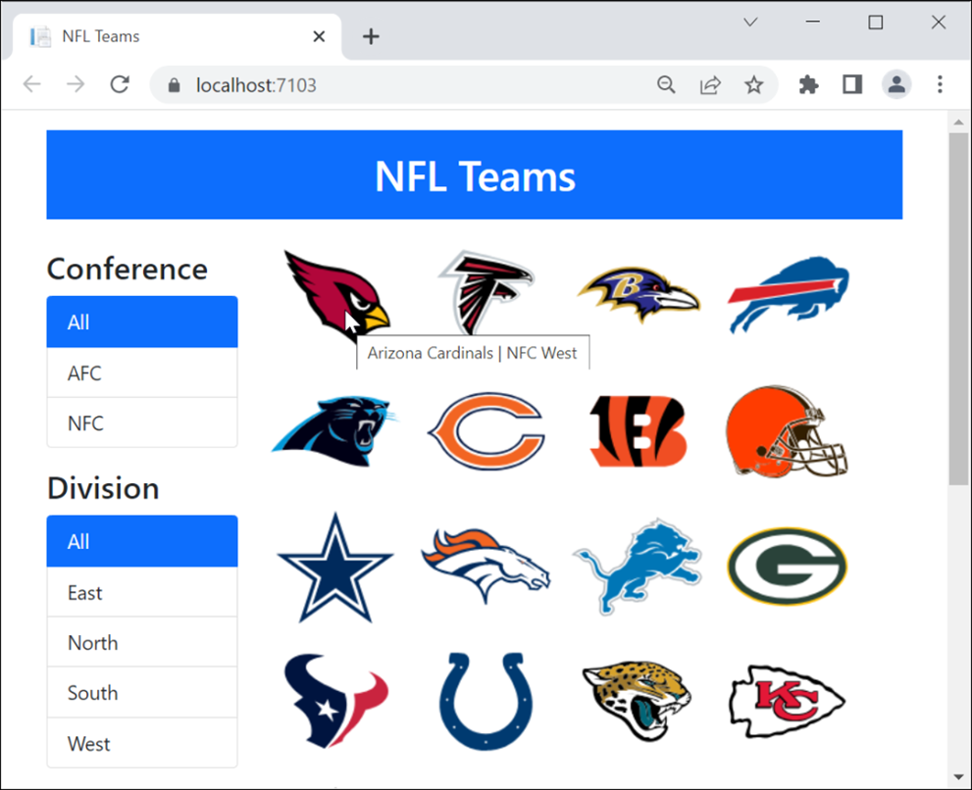
The NFL Teams app on first load

Slide 20
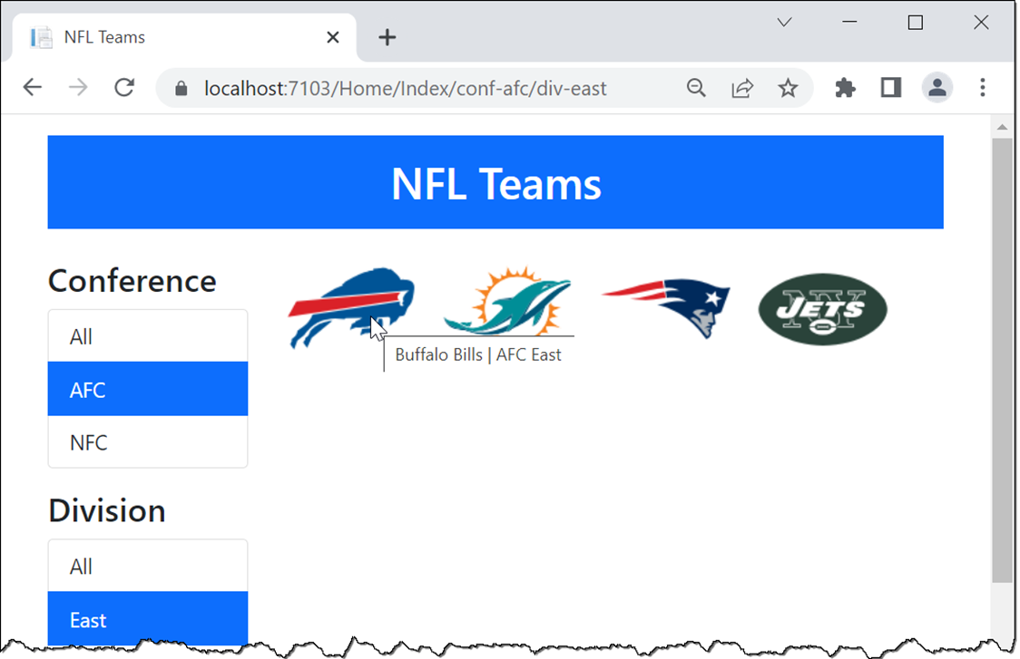
The NFL Teams app after a conference and division are selected

Slide 21
The Conference class
public class Conference
{
public string ConferenceID { get; set; } = string.Empty;
public string Name { get; set; } = string.Empty;
}
The Division class
public class Division
{
public string DivisionID { get; set; } = string.Empty;
public string Name { get; set; } = string.Empty;
}
The Team class
public class Team
{
public string TeamID { get; set; } = string.Empty;
public string Name { get; set; } = string.Empty;
public Conference Conference { get; set; } = null!;
public Division Division { get; set; } = null!;
public string LogoImage { get; set; } = string.Empty;
}

Slide 22
The TeamContext class (part 1)
public class TeamContext : DbContext
{
public TeamContext(DbContextOptions<TeamContext> options)
: base(options) { }
public DbSet<Team> Teams { get; set; } = null!;
public DbSet<Conference> Conferences { get; set; } = null!;
public DbSet<Division> Divisions { get; set; } = null!;
protected override void OnModelCreating(
ModelBuilder modelBuilder) {
base.OnModelCreating(modelBuilder);
modelBuilder.Entity<Conference>().HasData(
new Conference { ConferenceID = "afc", Name = "AFC"},
...
);
modelBuilder.Entity<Division>().HasData(
new Division { DivisionID = "north", Name = "North" },
...
);

Slide 23
The TeamContext class (part 2)
modelBuilder.Entity<Team>().HasData(
new {TeamID = "ari", Name = "Arizona Cardinals",
ConferenceID = "nfc", DivisionID = "west",
LogoImage = "ARI.png"},
...
);
}
}

Slide 24
The Home controller (part 1)
public class HomeController : Controller
{
private TeamContext context;
public HomeController(TeamContext ctx)
{
context = ctx;
}
public ViewResult Index(string activeConf = "all",
string activeDiv = "all")
{
// store selected conference and division IDs in view bag
ViewBag.ActiveConf = activeConf;
ViewBag.ActiveDiv = activeDiv;
// store conferences and divisions from database in view bag
ViewBag.Conferences = context.Conferences.ToList();
ViewBag.Divisions = context.Divisions.ToList();

Slide 25
The Home controller (part 2)
// get teams - filter by conference and division
IQueryable<Team> query = context.Teams.OrderBy(t => t.Name);
if (activeConf != "all")
query = query.Where(
t => t.Conference.ConferenceID.ToLower() ==
activeConf.ToLower());
if (activeDiv != "all")
query = query.Where(
t => t.Division.DivisionID.ToLower() ==
activeDiv.ToLower());
// pass list of teams to view as model
var teams = query.ToList();
return View(teams);
}
}

Slide 26
The custom route in the Program.cs file
app.MapControllerRoute(
name: "custom",
pattern:
"{controller}/{action}/conf-{activeConf}/div-{activeDiv}");
app.MapControllerRoute(
name: "default",
pattern: "{controller=Home}/{action=Index}/{id?}");

Slide 27
The layout
<!DOCTYPE html>
<html>
<head>
<meta name="viewport" content="width=device-width,
initial-scale=1.0" />
<link href="~/lib/bootstrap/dist/css/bootstrap.min.css"
rel="stylesheet" />
<link href="~/css/site.css" rel="stylesheet" />
<title>@ViewBag.Title</title>
</head>
<body>
<div class="container">
<header class="text-center text-white">
<h1 class="bg-primary mt-3 p-3">NFL Teams</h1>
</header>
<main>
@RenderBody()
</main>
</div>
</body>
</html>

Slide 28
The Home/Index view (part 1)
@model IEnumerable<Team>
@{
ViewData["Title"] = "NFL Teams";
string Active(string filter, string selected) {
return (filter.ToLower() == selected.ToLower()) ?
"active" : "";
}
}
<div class="row">
<div class="col-md-3">
<h3 class="mt-3">Conference</h3>
<div class="list-group">
<a asp-action="Index"
asp-route-activeConf="all"
asp-route-activeDiv="@ViewBag.ActiveDiv"
class="list-group-item @Active("all",
ViewBag.ActiveConf)">
All</a>

Slide 29
The Home/Index view (part 2)
@foreach (Conference conf in ViewBag.Conferences) {
<a asp-action="Index"
asp-route-activeConf="@conf.ConferenceID"
asp-route-activeDiv="@ViewBag.ActiveDiv"
class="list-group-item @Active(conf.ConferenceID,
ViewBag.ActiveConf)">
@conf.Name</a>
}
</div>
<h3 class="mt-3">Division</h3>
<div class="list-group">
<a asp-action="Index"
asp-route-activeConf="@ViewBag.ActiveConf"
asp-route-activeDiv="all"
class="list-group-item @Active("all",
ViewBag.ActiveDiv)">
All</a>

Slide 30
The Home/Index view (part 3)
@foreach (Division div in ViewBag.Divisions) {
<a asp-action="Index"
asp-route-activeConf="@ViewBag.ActiveConf"
asp-route-activeDiv="@div.DivisionID"
class="list-group-item @Active(div.DivisionID,
ViewBag.ActiveDiv)">
@div.Name</a>
}
</div>
</div>
<div class="col-md-9">
<ul class="list-inline">
@foreach (Team team in Model) {
<li class="list-inline-item">
<img src="~/images/@team.LogoImage"
alt="@team.Name"
title="@team.Name |
@team.Conference.Name @team.Division.Name" />
</li>
}
</ul>
</div>
</div>

Slide 31
A view model for the NFL Teams app
public class TeamsViewModel
{
public string ActiveConf { get; set; } = "all";
public string ActiveDiv { get; set; } = "all";
public List<Team> Teams { get; set; } = new List<Team>();
public List<Conference> Conferences { get; set; } =
new List<Conference>();
public List<Division> Divisions { get; set; } =
new List<Division>();
// methods to help view determine active link
public string CheckActiveConf(string c) =>
c.ToLower() == ActiveConf.ToLower() ? "active" : "";
public string CheckActiveDiv(string d) =>
d.ToLower() == ActiveDiv.ToLower() ? "active" : "";
}

Slide 32
The updated Index() action method of the Home controller
public ViewResult Index(TeamsViewModel model)
{
model.Conferences = context.Conferences.ToList();
model.Divisions = context.Divisions.ToList();
IQueryable<Team> query = context.Teams.OrderBy(t => t.Name);
if (model.ActiveConf != "all")
query = query.Where(t =>
t.Conference.ConferenceID.ToLower() ==
model.ActiveConf.ToLower());
if (model.ActiveDiv != "all")
query = query.Where(t =>
t.Division.DivisionID.ToLower() ==
model.ActiveDiv.ToLower());
model.Teams = query.ToList();
return View(model);
}

Slide 33
The updated Home/Index view (part 1)
@model TeamsViewModel
@{ ViewData["Title"] = "NFL Teams"; // helper function not needed }
<div class="row">
<div class="col-md-3">
<h3 class="mt-3">Conference</h3>
<div class="list-group">
<a asp-action="Index"
asp-route-activeConf="all"
asp-route-activeDiv="@Model.ActiveDiv"
class="list-group-item
@Model.CheckActiveConf("all")">
All</a>
@foreach (Conference conf in Model.Conferences) {
<a asp-action="Index"
asp-route-activeConf="@conf.ConferenceID"
asp-route-activeDiv="@Model.ActiveDiv"
class="list-group-item
@Model.CheckActiveConf(conf.ConferenceID)">
@conf.Name</a>
}
</div>

Slide 34
The updated Home/Index view (part 2)
<h3 class="mt-3">Division</h3>
...
</div>
<div class="col-md-9">
<ul class="list-inline">
@foreach (Team team in Model.Teams)
...
}
</ul>
</div>
</div>

Slide 35
Two of the HTTP status codes for redirection
302 Found
301 Moved Permanently
The ActionResult subtypes for redirection
Subtype | 302 Found method | 301 Moved Permanently method
RedirectResult | Redirect() | RedirectPermanent()
LocalRedirectResult | LocalRedirect() | LocalRedirectPermanent()
RedirectToActionResult | RedirectToAction() | RedirectToActionPermanent()
RedirectToRouteResult | RedirectToRoute() | RedirectToRoutePermanent()

Slide 36
How to know which subtype to use for redirection
Subtype | Use when…
RedirectResult | Redirecting to an external URL, such as https://google.com.
LocalRedirectResult | Making sure you redirect to a URL within the current app.
RedirectToActionResult | Redirecting to an action method within the current app.
RedirectToRouteResult | Redirecting within the current app by using a named route.

Slide 37
Some of the overloads available for the RedirectToAction() method
Arguments | Redirect to…
(a) | The specified action method in the current controller.
(a, c) | The specified action method in the specified controller.
(a, routes) | The specified action method in the current controller with route parameters.
(a, c, routes) | The specified action method in the specified controller with route parameters.

Slide 38
Code that redirects to another action method (part 1)
The List() action method in the current controller
public RedirectToActionResult Index() =>
RedirectToAction("List");
The List() action method in the Team controller
public RedirectToActionResult Index() =>
RedirectToAction("List", "Team");
The Details() action method in the current controller with a parameter
public RedirectToActionResult Index(string id) =>
RedirectToAction("Details", new { ID = id });

Slide 39
Code that redirects to another action method (part 2)
Use a shortcut when variable name and route segment name match
public RedirectToActionResult Index(string id) =>
RedirectToAction("Details", new { id });
Use a string-string dictionary to supply parameters
public RedirectToActionResult Index(string id) =>
RedirectToAction("Details",
new Dictionary<string, string>(){ { "ID", id } } );

Slide 40
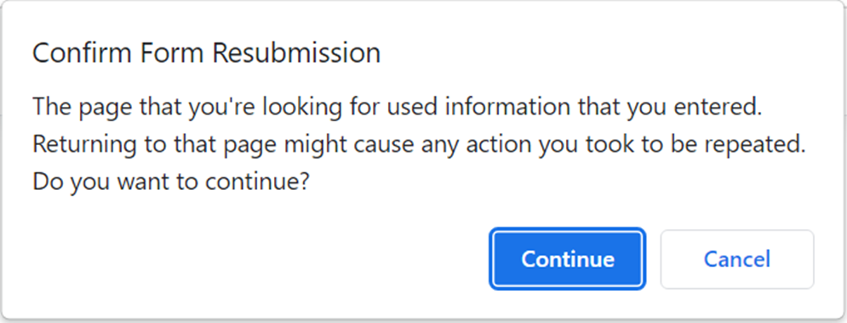
A browser message that’s displayed when you refresh a page displayed by a POST request

Slide 41
Code that uses the Post-Redirect-Get (PRG) pattern
An action method that handles a POST request
[HttpPost] // Post
public RedirectToActionResult Add(Team team)
{
// code that updates the server
// with the new team data
return RedirectToAction("Index", "Home"); // Redirect
}
The action method the POST action method redirects to
[HttpGet] // Get
public ViewResult Index(TeamsViewModel model)
{
// code that reads the updated data from the server
return View(model);
}

Slide 42
Code that uses TempData with the PRG pattern
An action method for a POST request that stores a string in TempData
[HttpPost]
public RedirectToActionResult Add(Team team)
{
// code that updates the server with the new team data
TempData["message"] = $"{team.Name} added to your favorites";
return RedirectToAction("Index", "Home");
}
An action method for a GET request that retrieves a string from TempData
[HttpGet]
public ViewResult Index(TeamsViewModel model)
{
// code that reads the updated data from the server
ViewBag.Message = TempData["message"];
return View(model);
}

Slide 43
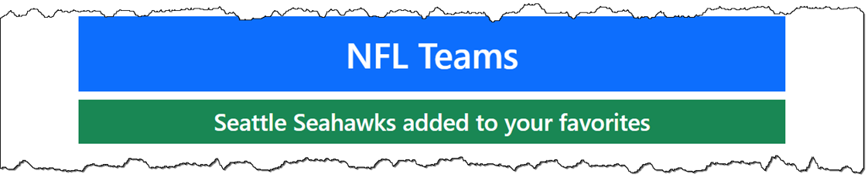
A Layout view that checks for a TempData value and displays it if it exists
...
@if (TempData.Keys.Contains("message"))
{
<h4 class="bg-success p-2">@TempData["message"]</h4>
}
...
How it looks in a browser when a TempData value exists

Slide 44
Two methods of the TempDataDictionary class
Keep()
Keep(key)
Peek(key)

Slide 45
The overloaded Details() action method of the Home controller (part 1)
[HttpPost]
public RedirectToActionResult Details(TeamsViewModel model)
{
Utility.LogTeamClick(model.Team.TeamID);
TempData["ActiveConf"] = model.ActiveConf;
TempData["ActiveDiv"] = model.ActiveDiv;
return RedirectToAction("Details",
new { ID = model.Team.TeamID });
}

Slide 46
The overloaded Details() action method of the Home controller (part 2)
[HttpGet]
public ViewResult Details(string id)
{
var model = new TeamsViewModel {
Team = context.Teams
.Include(t => t.Conference)
.Include(t => t.Division)
.FirstOrDefault(t => t.TeamID == id),
ActiveConf = TempData.Peek("ActiveConf").ToString(),
ActiveDiv = TempData.Peek("ActiveDiv").ToString()
};
return View(model);
}

Slide 47
When to use the Keep() and Peek() methods
Use Peek() when you know you want the value to stay marked as unread.
Use a normal read and Keep() when you want to use a condition to determine whether to mark the value as unread.

Slide 48
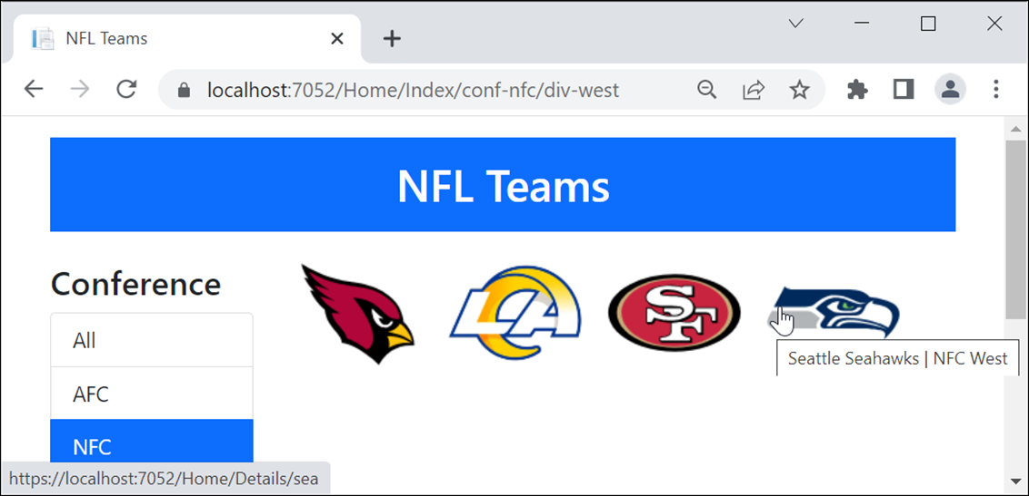
The Home page with image links for the team logos

Slide 49
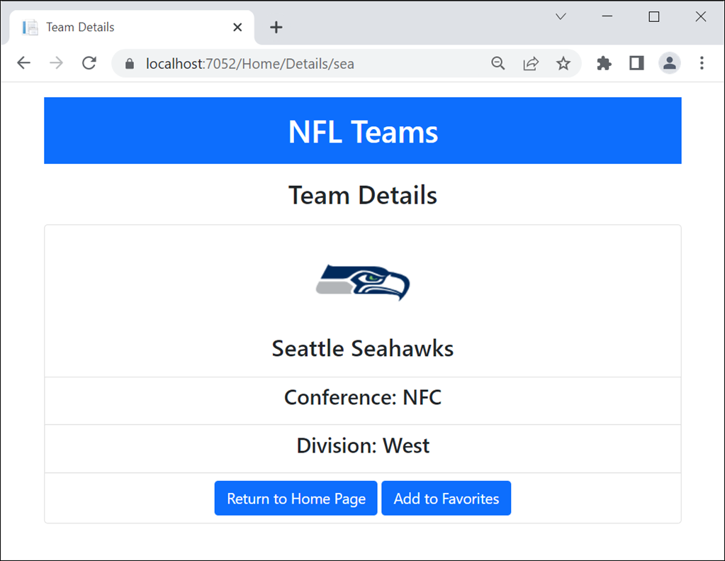
The Details page after clicking on a team logo

Slide 50
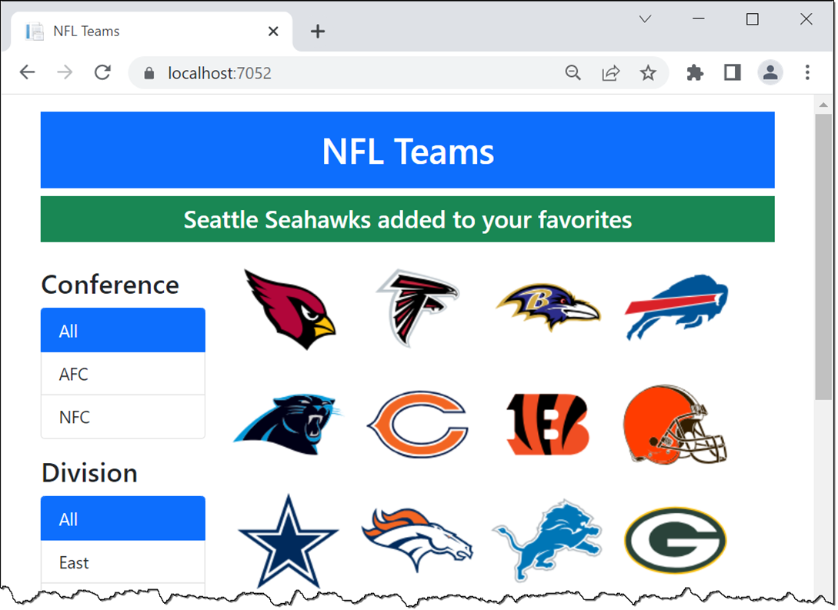
The Home page after adding a team to favorites

Slide 51
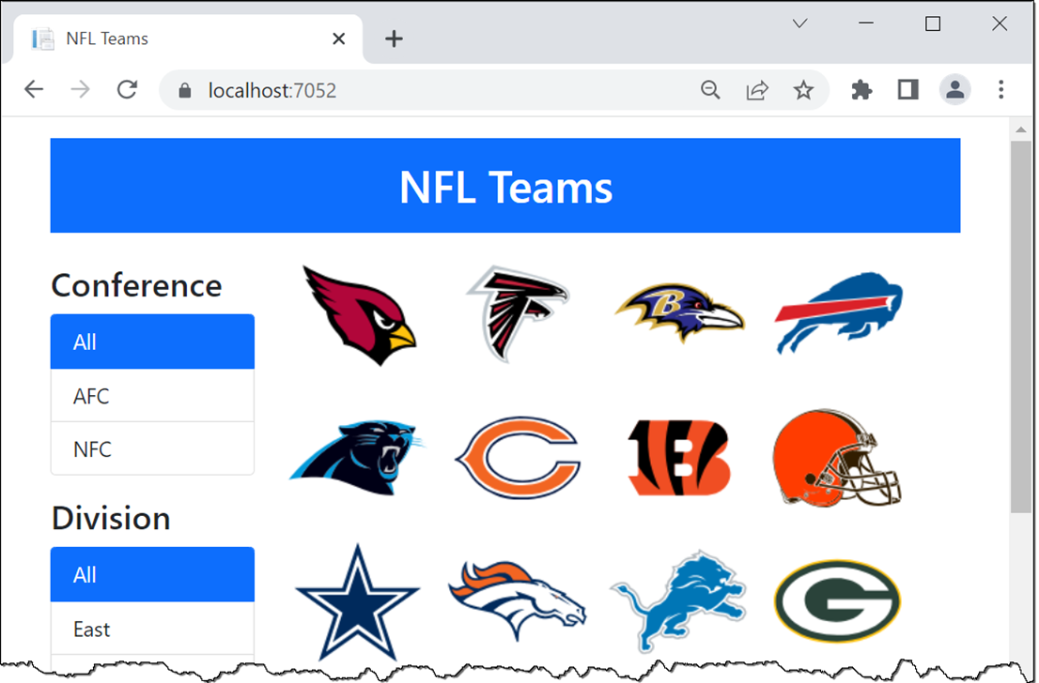
The Home page after clicking the browser’s refresh button

Slide 52
The Razor loop in the Home/Index view that displays the team logos
@foreach (Team team in Model.Teams)
{
<li class="list-inline-item">
<a asp-action="Details"
asp-route-id="@team.TeamID">
<img src="~/images/@team.LogoImage"
alt="@team.Name"
title="@team.Name |
@team.Conference.Name
@team.Division.Name" />
</a>
</li>
}

Slide 53
The Details() action method of the Home controller
public IActionResult Details(string id)
{
var team = context.Teams
.Include(t => t.Conference)
.Include(t => t.Division)
.FirstOrDefault(t => t.TeamID == id) ??
new Team();
return View(team);
}

Slide 54
The Home/Details view (part 1)
@model Team
@{
ViewData["Title"] = "Team Details";
}
<h2 class="text-center p-2">Team Details</h2>
<div class="row">
<div class="col">
<ul class="list-group text-center">
<li class="list-group-item">
<img src="~/images/@Model.LogoImage" alt="" />
<h3>@Model.Name</h3></li>
<li class="list-group-item">
<h4>Conference: @Model.Conference.Name</h4></li>
<li class="list-group-item">
<h4>Division: @Model.Division.Name</h4></li>

Slide 55
The Home/Details view (part 2)
<li class="list-group-item">
<form method="post" asp-action="Add"
asp-controller="Favorites">
<a asp-action="Index" class="btn btn-primary">
Return to Home Page</a>
<button type="submit" class="btn btn-primary">
Add to Favorites</button>
<input type="hidden" asp-for="@Model.TeamID" />
<input type="hidden" asp-for="@Model.Name" />
</form>
</li>
</ul>
</div>
</div>

Slide 56
The Add() action method of the Favorites controller
[HttpPost]
public RedirectToActionResult Add(Team team)
{
// code to store favorite team in session goes here
TempData["message"] =
$"{team.Name} added to your favorites";
return RedirectToAction("Index", "Home");
}

Slide 57
The Layout view (part 1)
<!DOCTYPE html>
<html>
<head>
<meta name="viewport" content="width=device-width" />
<link href="~/lib/bootstrap/dist/css/bootstrap.min.css"
rel="stylesheet" />
<link href="~/css/site.css" rel="stylesheet" />
<title>@ViewBag.Title</title>
</head>
<body>
<div class="container">
<header class="text-center text-white">
<h1 class="bg-primary mt-3 p-3">NFL Teams</h1>
@* show any message in TempData *@
@if (TempData.Keys.Contains("message"))
{
<h4 class="bg-success p-2">@TempData["message"]</h4>
}
</header>

Slide 58
The Layout view (part 2)
<main>
@RenderBody()
</main>
</div>
</body>
</html>

